Slide 1
Chapter 3: Operational Amplifiers
Module 2 : Linear Applications
Reference: Robert L. Boylestad, Louis Nashelsky, Electronic Devices & Circuits Theory, 11th Edition, PHI, 2012

Slide 2
Objectives
Discuss OPAMP based amplifier topologies.
Analyse and design OPAMP based circuits for simple
mathematical operations.

Slide 3
Linear Applications of OpAmp
Inverting amplifier
Non-inverting amplifier
Voltage follower
Summing amplifier
Difference amplifier
Integrator
Differentiator

Slide 4
Why feedback

Slide 5
Thumb Rule
No current enters OpAmp
Negative feedback - limited gain - for amplifiers
Positive feedback - for oscillators/ signal generators
Whenever feedback is used, output of OpAmp is such that voltage at inverting and non inverting pins are almost the same.

Slide 6
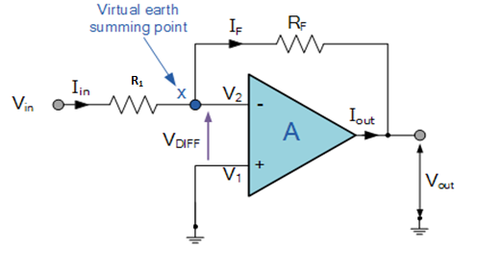
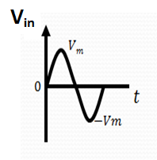
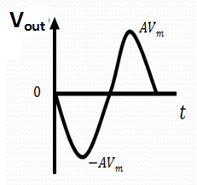
Inverting Amplifier

Slide 7
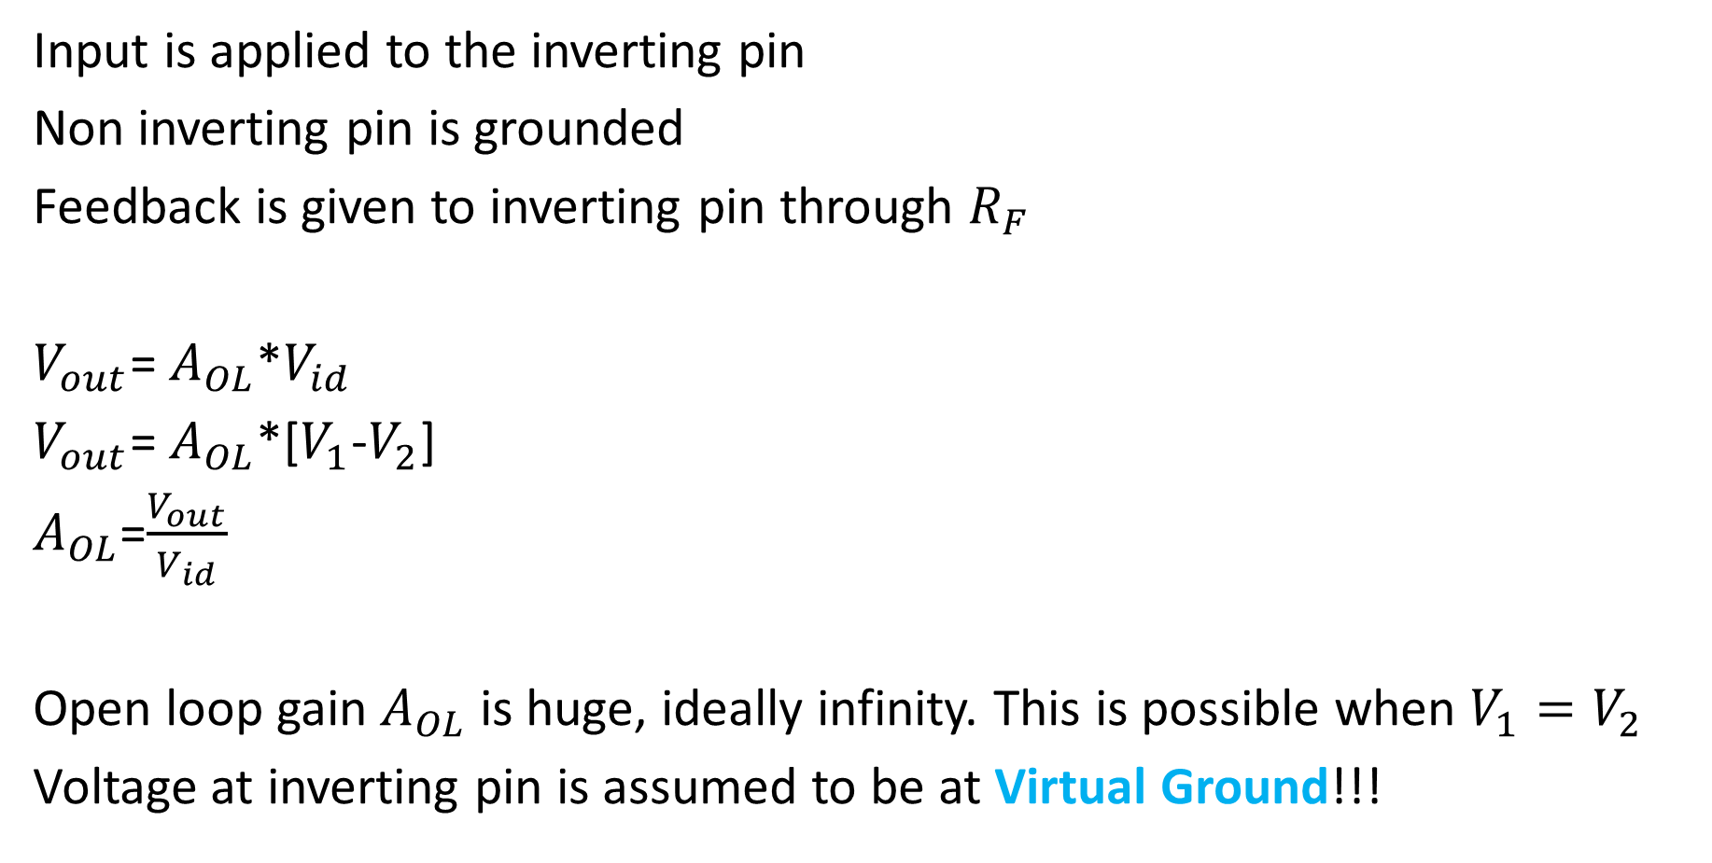
Input is applied to the inverting pin
Non inverting pin is grounded
Feedback is given to inverting pin through $R_{F}$
$V_{out}$= $A_{OL}$*$V_{id}$
$V_{out}$= $A_{OL}$*[$V_{1}$-$V_{2}$]
$A_{OL}$=$\frac{V_{out}}{V_{id}}$
Open loop gain $A_{OL}$ is huge, ideally infinity. This is possible when $V_{1}=V_{2}$
Voltage at inverting pin is assumed to be at Virtual Ground!!!

Slide 8
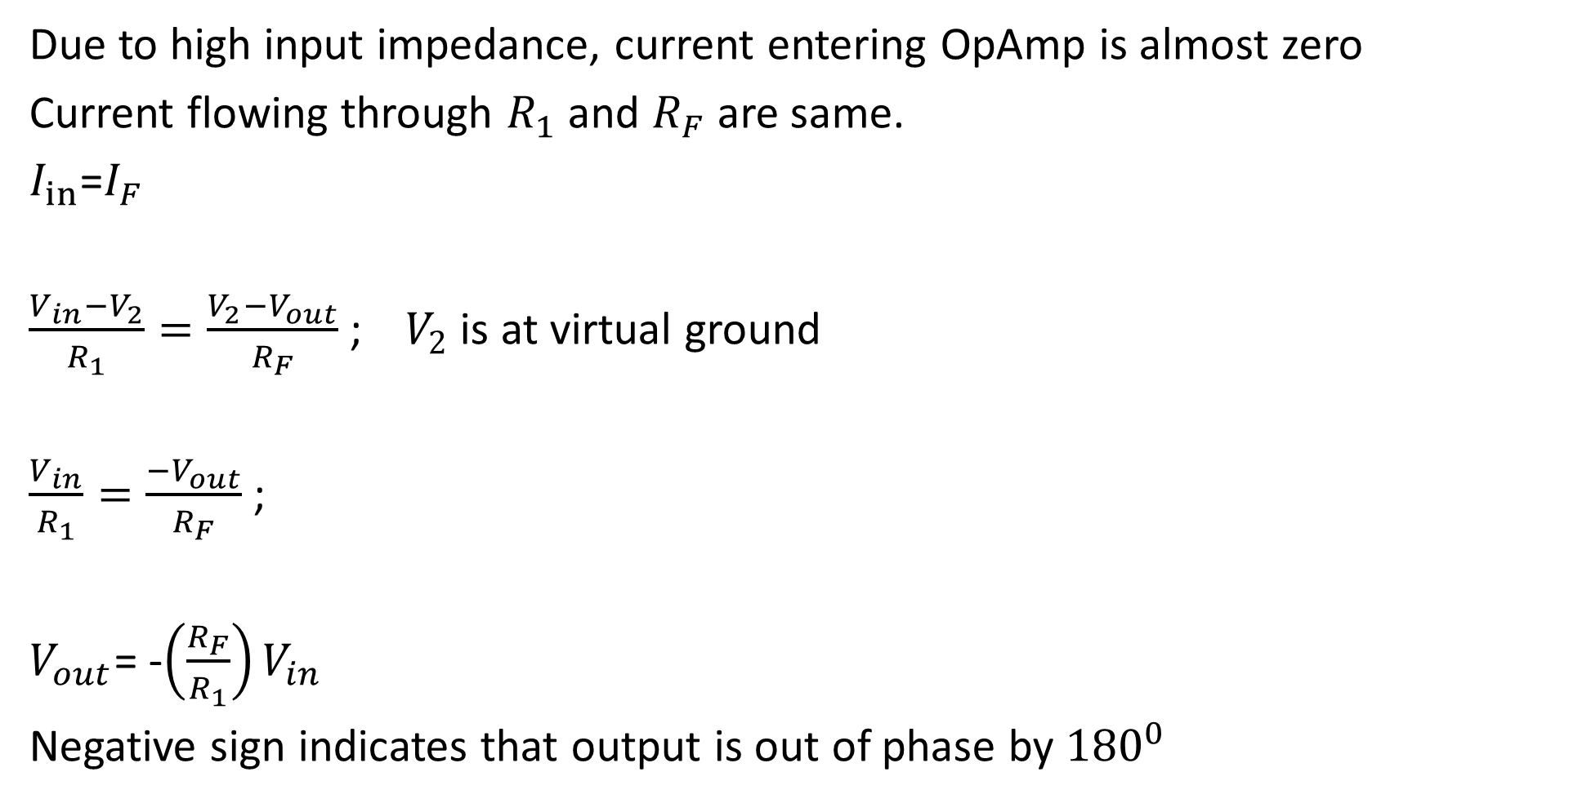
Due to high input impedance, current entering OpAmp is almost zero
Current flowing through $R_{1}$ and $R_{F}$ are same.
$I_{in}$=$I_{F}$
$\frac{V_{in}−V_{2}}{R_{1}}=\frac{V_{2}−V_{out}}{R_{F}}$ ; $V_{2}$ is at virtual ground
$\frac{V_{in}}{R_{1}}=\frac{−V_{out}}{R_{F}}$ ;
$V_{out}$= -$\left(\frac{R_{F}}{R_{1}}\right)V_{in}$
Negative sign indicates that output is out of phase by ${180}^{0}$

Slide 9
Concept of Virtual Ground

Slide 10
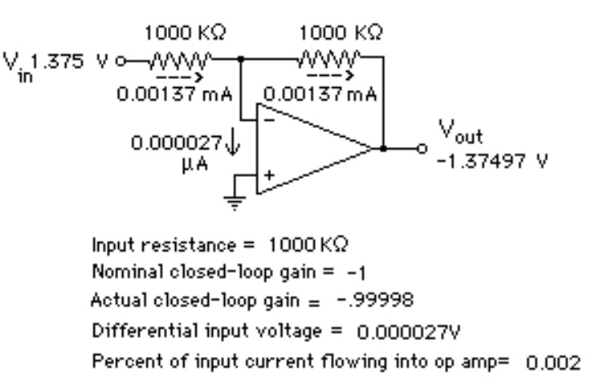
Practical Scenario / Example

Slide 11
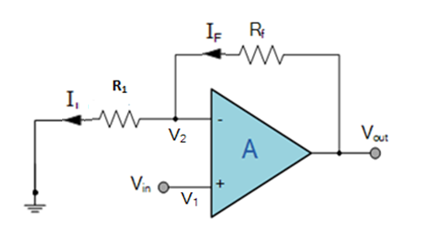
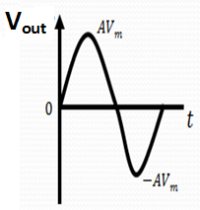
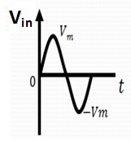
Non-Inverting Amplifier

Slide 12
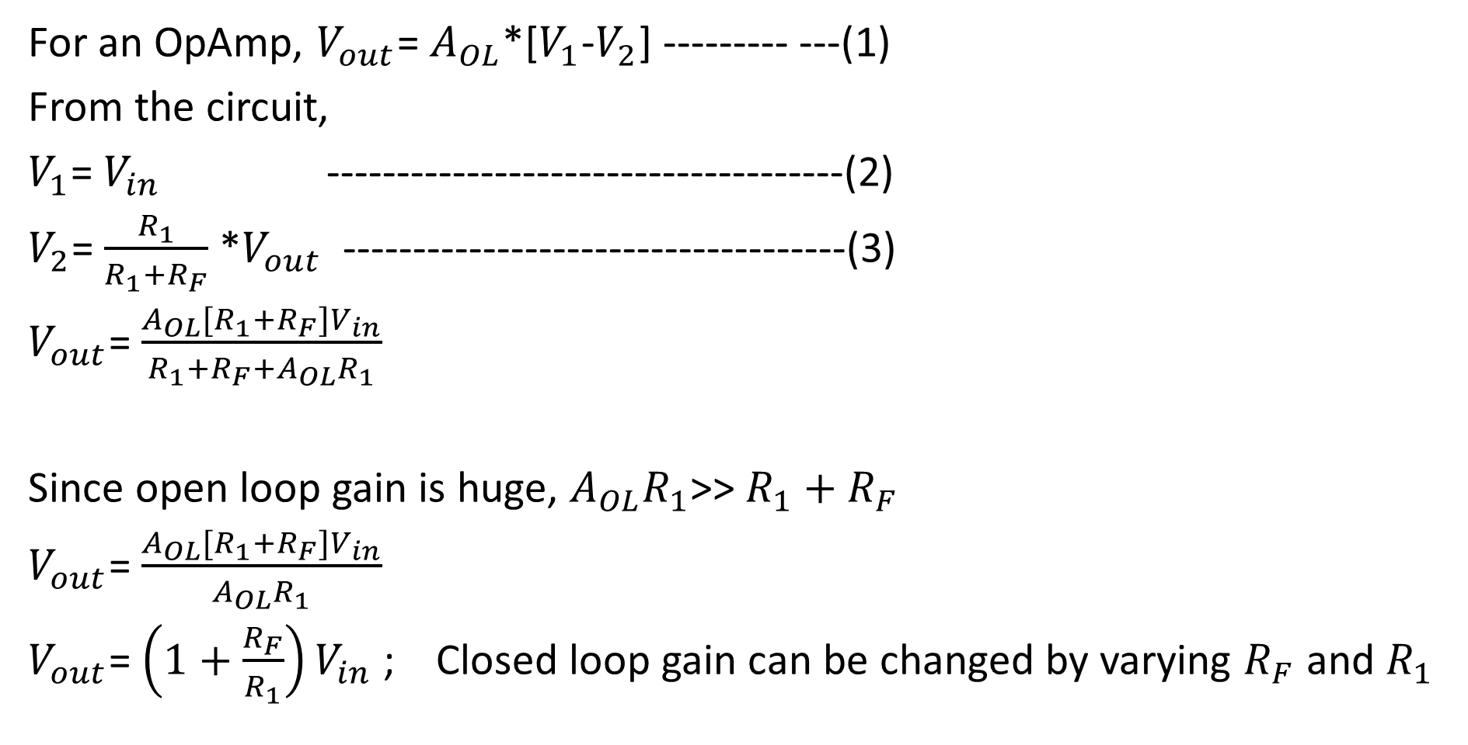
For an OpAmp, $V_{out}$= $A_{OL}$*[$V_{1}$-$V_{2}$] --------- ---(1)
From the circuit,
$V_{1}$= $V_{in}$ -------------------------------------(2)
$V_{2}$= $\frac{R_{1}}{R_{1}+R_{F}}$ *$V_{out}$ ------------------------------------(3)
$V_{out}$= $\frac{A_{OL}[R_{1}+R_{F}]V_{in}}{R_{1}+R_{F}+A_{OL}R_{1}}$
Since open loop gain is huge, $A_{OL}R_{1}$>> $R_{1}+R_{F}$
$V_{out}$= $\frac{A_{OL}[R_{1}+R_{F}]V_{in}}{A_{OL}R_{1}}$
$V_{out}$= $\left(1+\frac{R_{F}}{R_{1}}\right)V_{in}$ ; Closed loop gain can be changed by varying $R_{F}$ and $R_{1}$

Slide 13
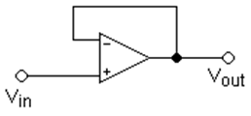
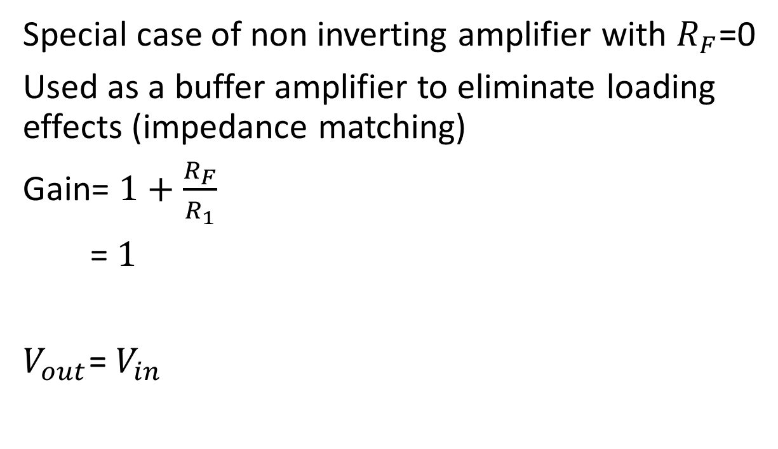
Voltage Follower
Special case of non inverting amplifier with $R_{F}$=0
Used as a buffer amplifier to eliminate loading effects (impedance matching)
Gain= $1+\frac{R_{F}}{R_{1}}$
=$1$
$V_{out}$= $V_{in}$

Slide 14
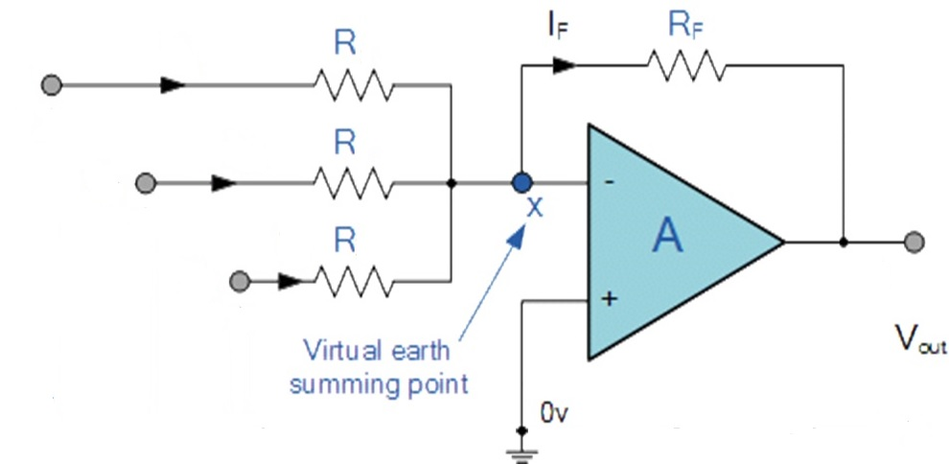
Summing Amplifier (inverting configuration)

Slide 16
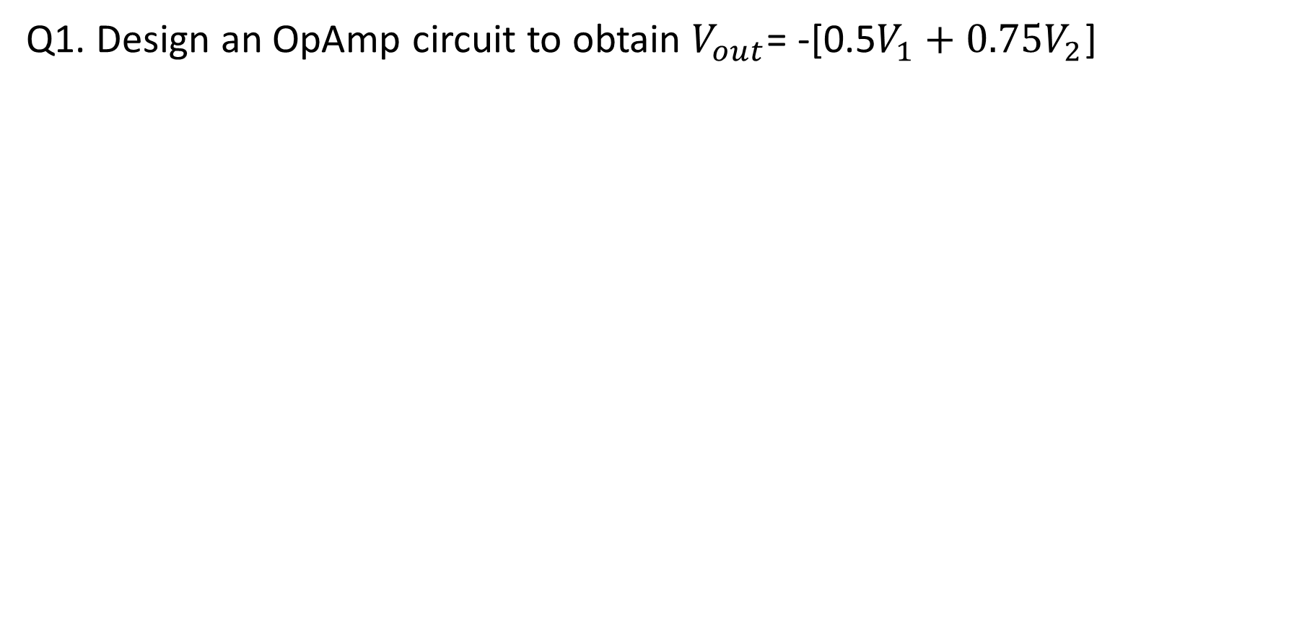
Q1. Design an OpAmp circuit to obtain $V_{out}$= -[0.5$V_{1}+{0.75V}_{2}$]

Slide 17
Summing Amplifier (non-inverting configuration)

Slide 18
Use superposition theorem to solve the circuit
Super Position Theorem
The effect of all the sources in a circuit is equal to the sum of the effect of each source taken separately in the same circuit.

Slide 19
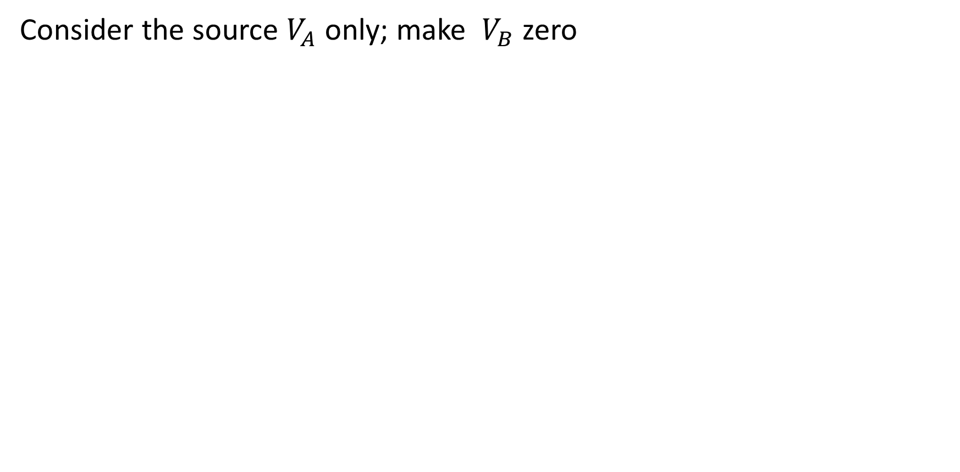
Consider the source $V_{A}$only; make $V_{B}$ zero

Slide 20
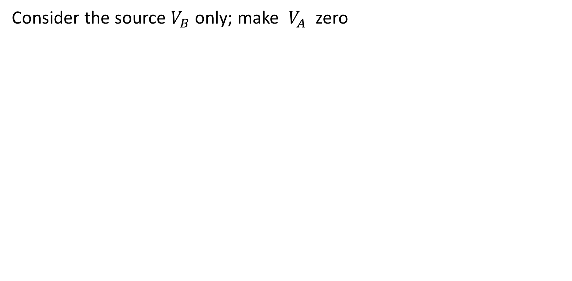
Consider the source $V_{B}$only; make $V_{A}$ zero

Slide 21
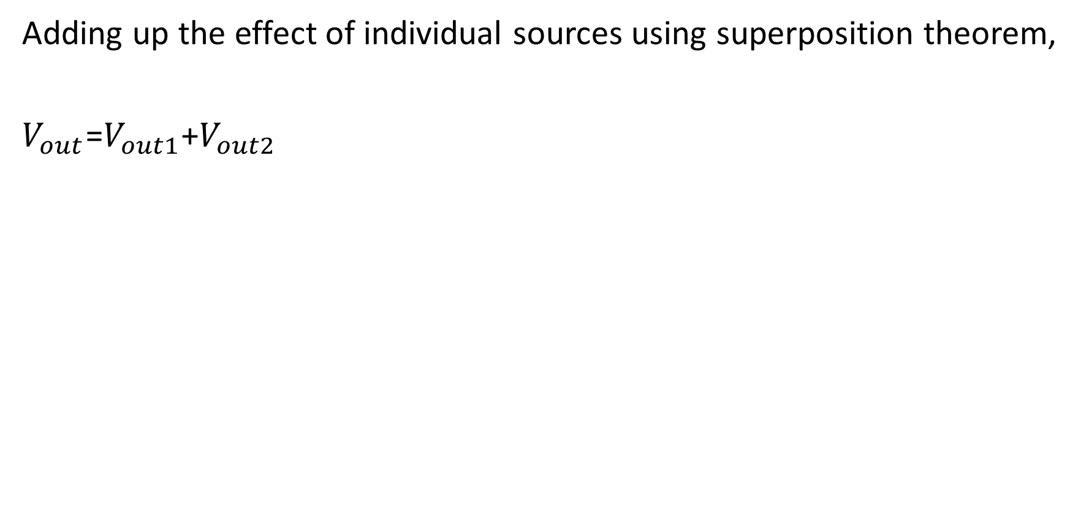
Adding up the effect of individual sources using superposition theorem,
$V_{out}$=$V_{out1}$+$V_{out2}$

Slide 22
Difference Amplifier

Slide 23
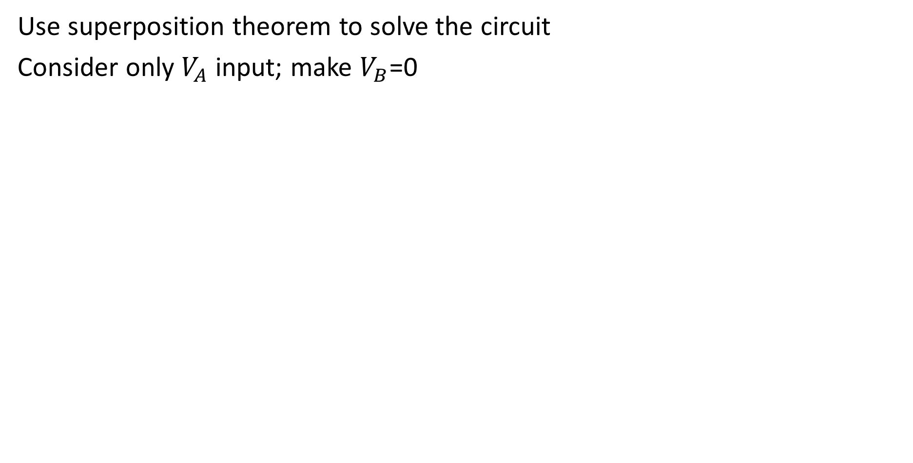
Use superposition theorem to solve the circuit
Consider only $V_{A}$ input; make $V_{B}$=0

Slide 24
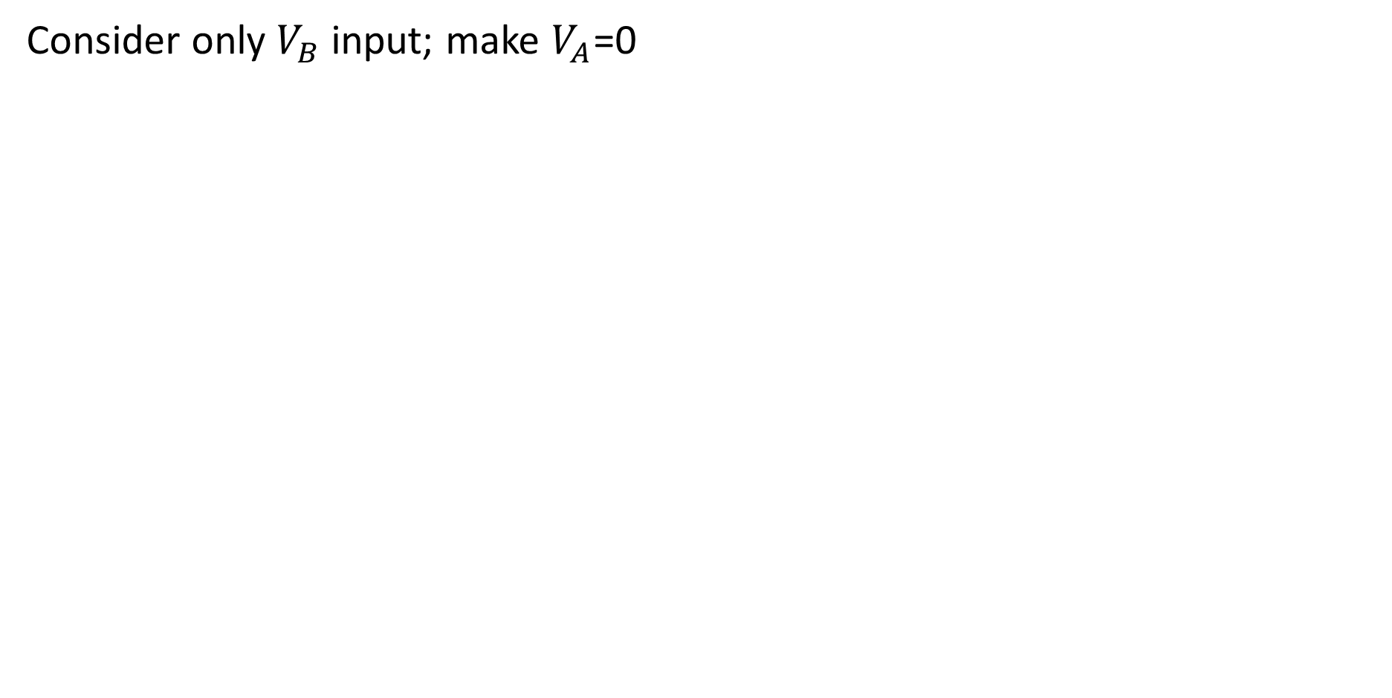
Consider only $V_{B}$ input; make $V_{A}$=0

Slide 25
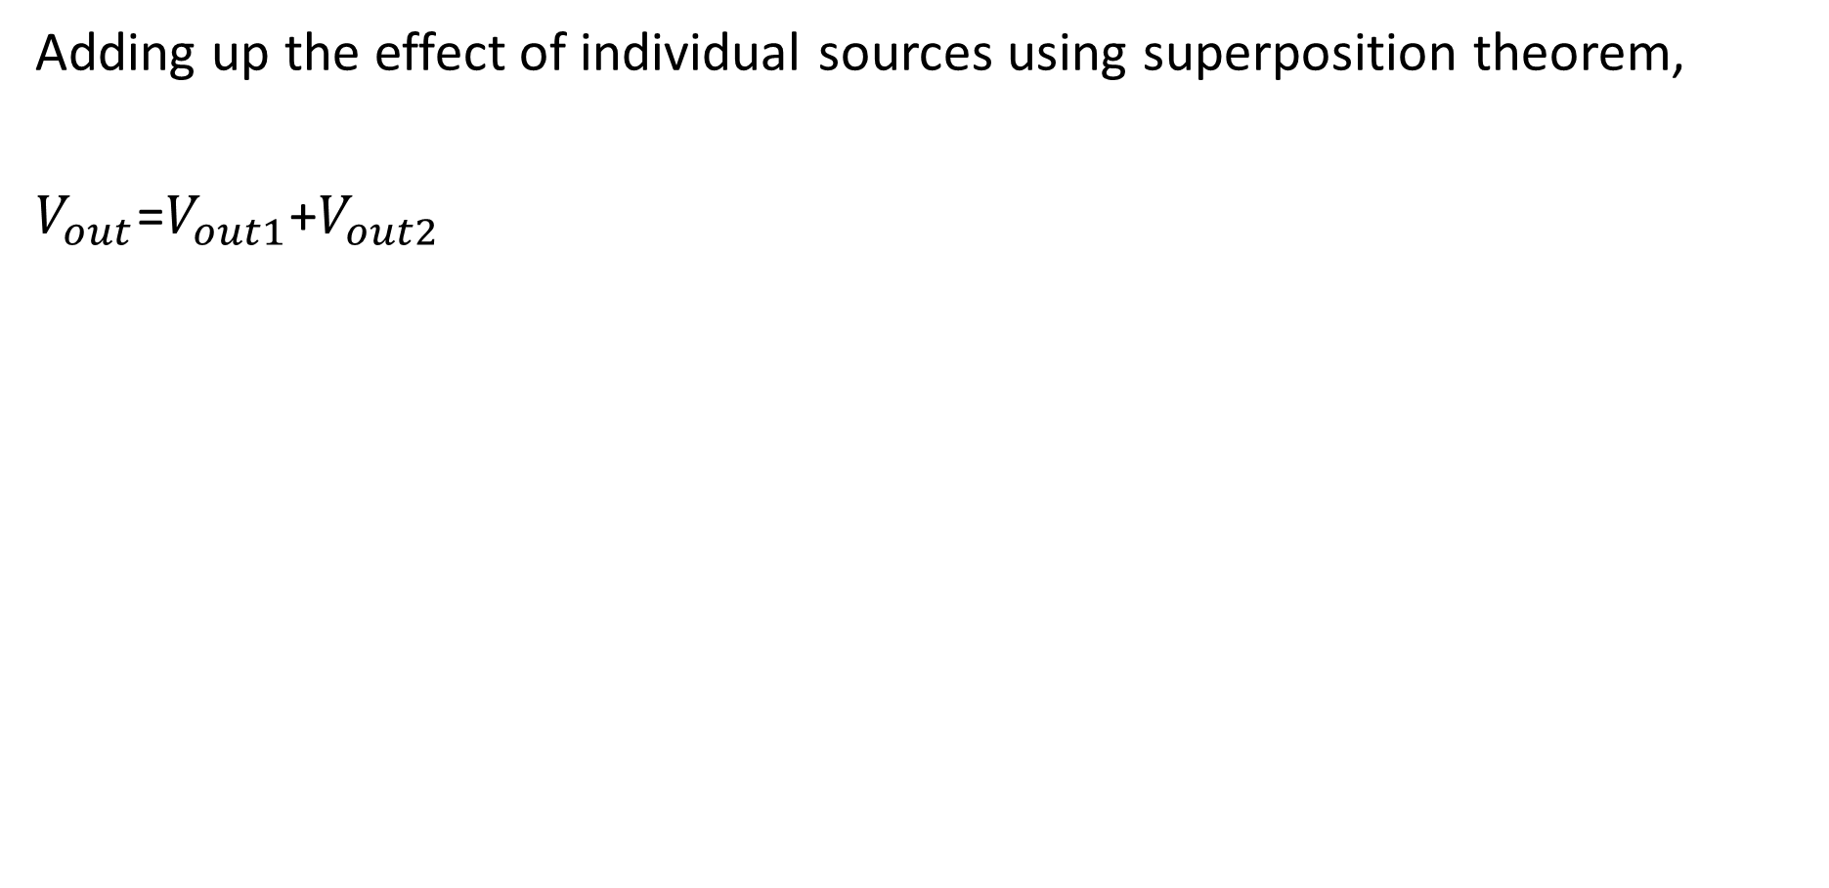
Adding up the effect of individual sources using superposition theorem,
$V_{out}$=$V_{out1}$+$V_{out2}$

Slide 26
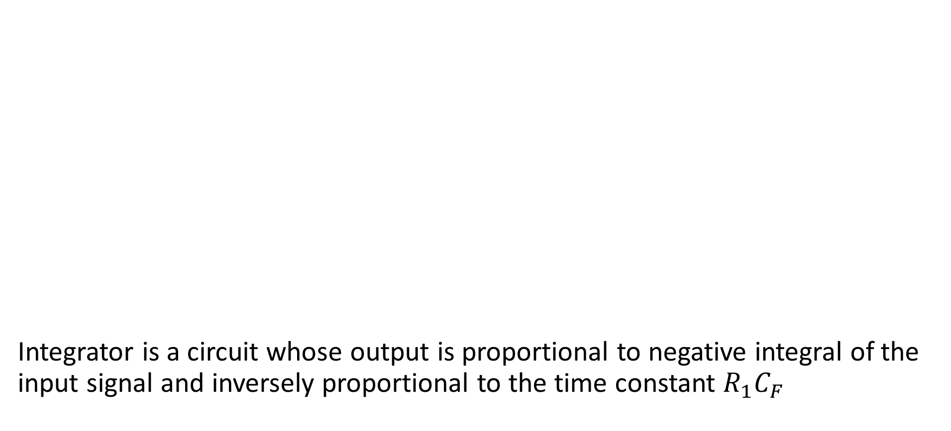
OpAmp Integrator Circuit
Integrator is a circuit whose output is proportional to negative integral of the input signal and inversely proportional to the time constant $R_{1}C_{F}$

Slide 29
OpAmp Integrator Waveforms

Slide 30
OpAmp Differentiator Circuit

Slide 32
OpAmp Differentiator Waveforms

Slide 33
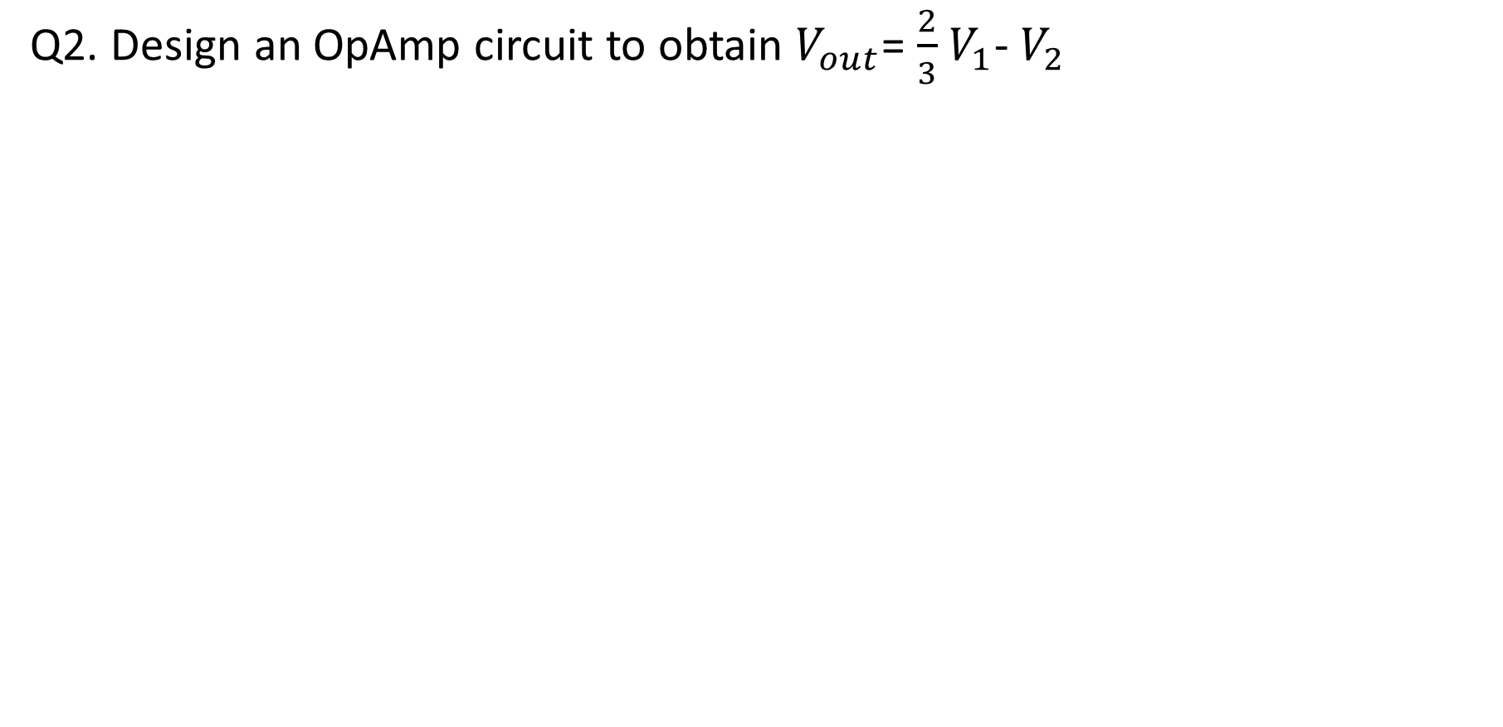
Q2. Design an OpAmp circuit to obtain $V_{out}$= $\frac{2}{3}$ $V_{1}$- $V_{2}$

Slide 34
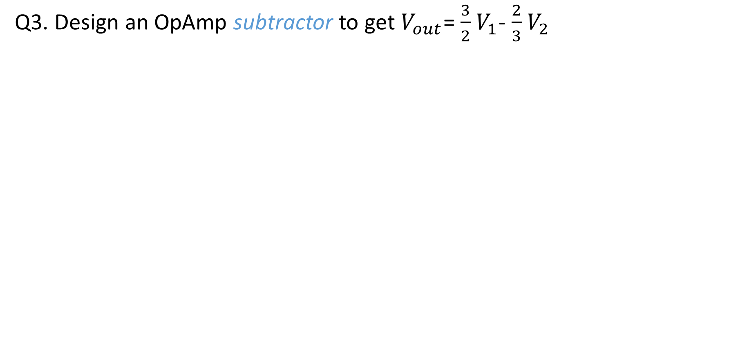
Q3. Design an OpAmp subtractor to get $V_{out}$= $\frac{3}{2}$ $V_{1}$- $\frac{2}{3}$ $V_{2}$

Slide 35
Alternate method:

Slide 36
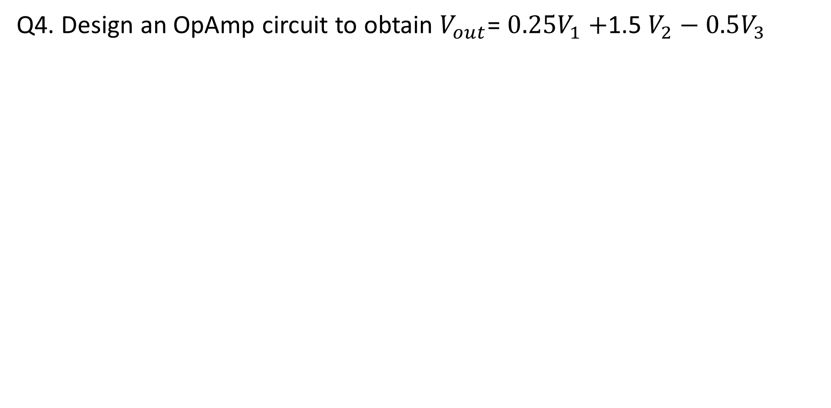
Q4. Design an OpAmp circuit to obtain $V_{out}$= $0.25V_{1}+$1.5 $V_{2}−0.5V_{3}$

Slide 37
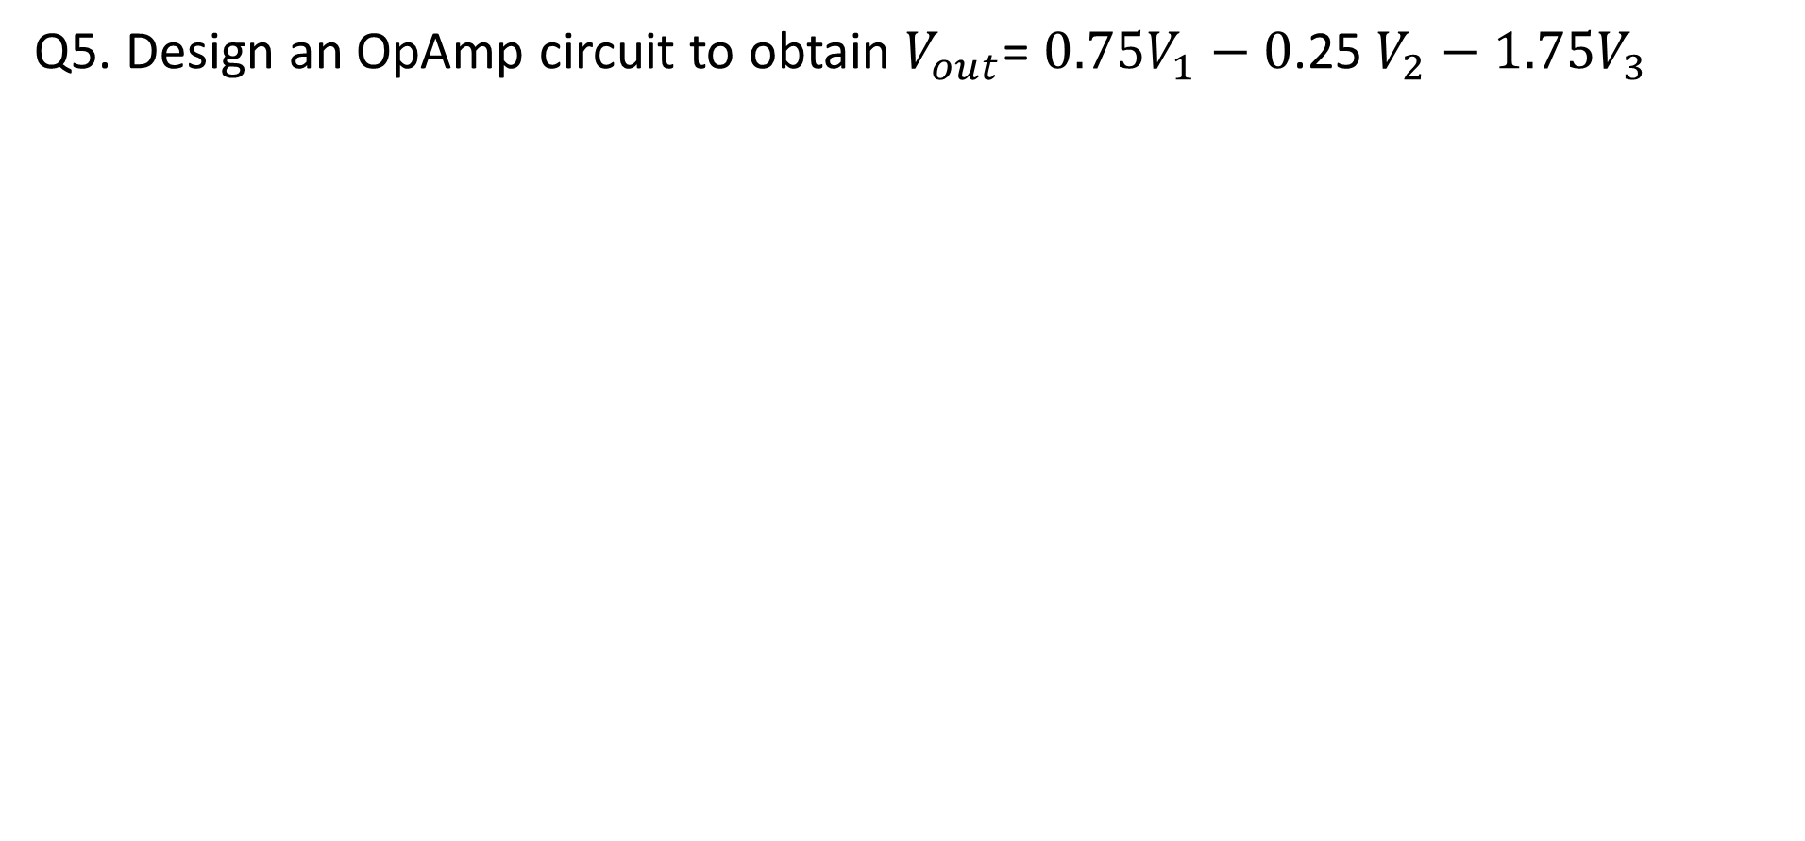
Q5. Design an OpAmp circuit to obtain $V_{out}$= $0.75V_{1}−0$.25 $V_{2}−1.75V_{3}$

Slide 38
Q6.Realize the equation using OpAmp V0= 3V1- 0.8V2 + 0.5V3

Slide 39
Q7a. 4V is applied to an OpAmp integrator shown below for 10m sec. Sketch the output waveform. Supply +/-10V

Slide 40
Q7b. 10V is applied to an OpAmp integrator shown below for 10m sec. Sketch the output waveform. Supply +/-10V

Slide 41
Q8.Sketch the output waveform for an inverting integrator if the input signal is square wave with amplitude is 5V and frequency 1KHz. Supply: +/- 15V

Slide 42
Q9. A 200mV peak to peak sine wave form voltage is applied to an OpAmp inverting amplifier with Rf/R1 =10. Sketch the output.

